Slide 1
Parts of an Ecosystem

Slide 2
By the end of the lesson, you should be able to:
1. Explain what a biotic factor is.
2. Explain what an abiotic factor is.

Slide 3

An ecosystem contains two key ingredients:
Biotic (living) factors
Abiotic (non-living) factors
Just as you need both flour and water to make bread, you need both biotic and abiotic factors for a healthy and functioning ecosystem.

Slide 4
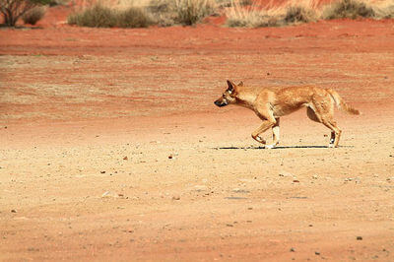
Biotic factors include all living things and their interactions with other organisms.
A hungry dingo is an example of a biotic factor. It interacts with small mammals by eating them.

Slide 5

An abiotic factor is a non-living part of the environment that affects the lives of organisms.
Water is an important abiotic factor. It is not alive, but many organisms live in it, drink it and use it for vital functions.

Slide 6


Slide 7
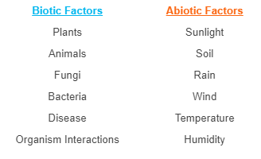
The table below includes some common examples of biotic and abiotic factors within ecosystems.
Don't bother memorising the whole list - we will look at the most important ones in more detail later.

